Slide 1
Topic 2: Enhancing the stock-robo advisor
By Anusha Desai, Kritik Jain, Neel Parimi, Vihaan Byahatti, and Roman Sherman

Slide 2
Table of conteNts
Introduction / Overview
Enhancements
Data Exploration
Algorithms
User Feedback and Interaction
Possible future enhancements

Slide 3




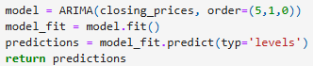
Introduction/ Overview
In order for us to make a more efficient and enhanced Robo-stock advisor, we would first need to know the original. This would be done by looking through the code and seeing the various parts like the Modularized codes for the ticker functions, the MAPE to compare the predictions and actual closing, and the ARIMA (the predictor). Knowing these we're able to make our enhancements

Slide 4
Enhancements in question
More variety of Modular functions and libraries:
Specified Annual return
Specified Sharpe ratio
Specified daily return
Specified Annual volatility
Easier comparisons of the calculations
Histogram based on annual return and Sharpe ratio Per ticker
UI for forecasting and predictions (more on this later)
Correlation heatmaps
This is a benefit as it allows for more calculations on specific parts of a stock.
Additionally it allows for easier access to information
A quick and easy way to compare the different parts of each stock. Additionally, it allows for users to make better decisions as there's a quick way to see and compare the performances of different stocks

Slide 5
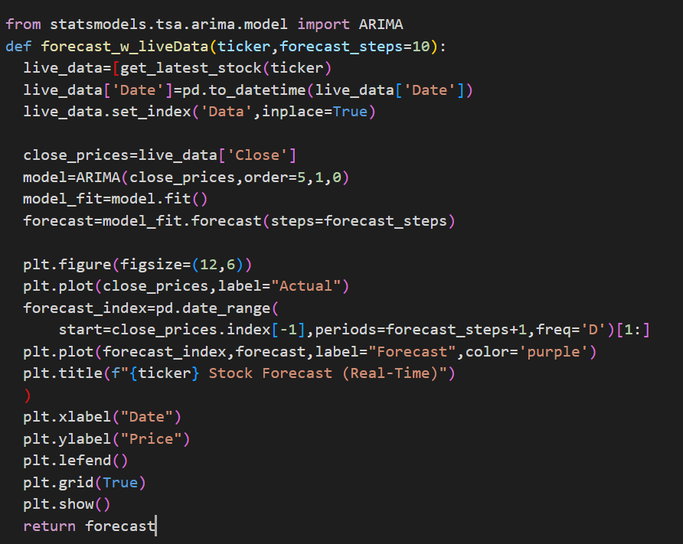
The main part...
This function dynamically gets us the stock prices latest using modes like Yahoo Finance. We fit in an Arima model to the closed prices and then we forecast for the next days. The model helps plot graphs for actual and predicted stocks. Thus, the system responds to market changes constantly, and this improves the accuracy for decision-making.

Slide 6
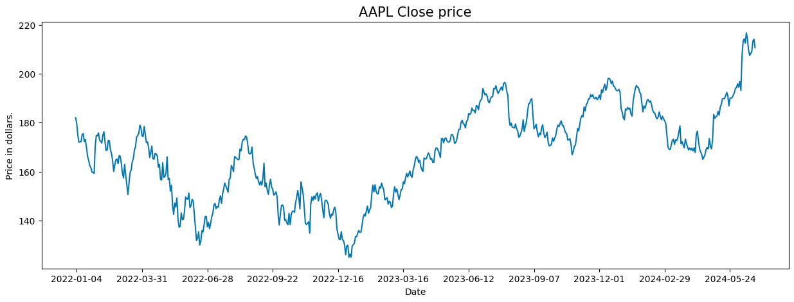
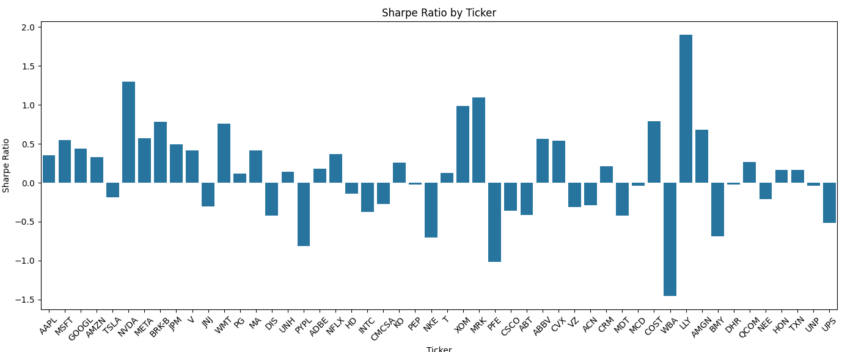
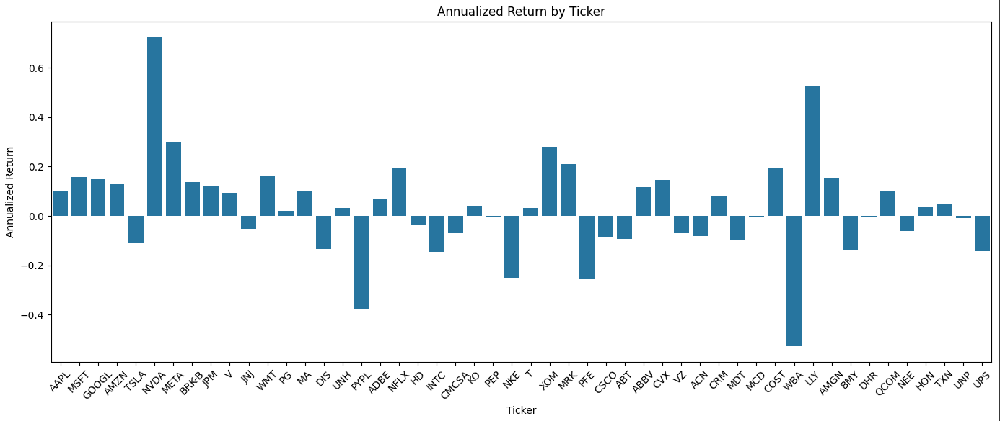
Data exploration AND findings
We were able to make graphs displaying the closing price of a ticker's stock over time.
We were able to make a histogram showing the Sharpe ratio of each ticker, showing the returns relative to risk (High Sharpe Ratio = Better Returns).
This graph shows the raw returns (not taking risk into account), allowing us to compare the returns of each stock.

Slide 7
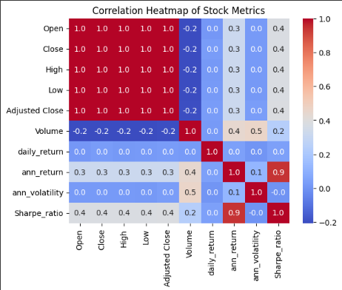
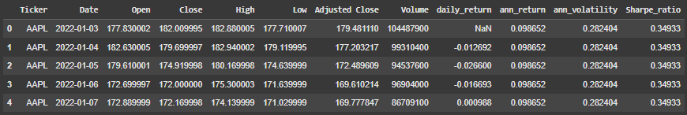
By creating a correlation heatmap of the different stock metrics, we were able to arrive at the following conclusions:
There are high correlations between (open, close, high, low, and adjusted close), (Sharpe ratio and Annual Return),
Moderate correlation for volume and annual volatility
Low to no correlation for all other combinations.
We also found each individual metric for the different stock metrics.
A possible stock metric that could be added is the earnings per share ratio, which shows the profitability of a company.

Slide 8
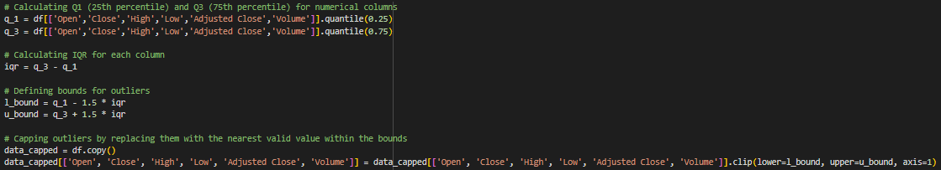
Lastly, this data was to be fed into model after first taking the IQR in order to reduce outliers.
This would help the model lessen the effect of outliers possibly skewing the dataset, predicted, and forecasted values.
We also found each individual metric for the different data.

Slide 9
algorithmS
We used clustering for group stocks to ensure similar behaviour based off of financial data like: Annualized return, Annualized Volatility, Sharpe Ratio. This helps us find the high performing and risky stocks, and balanced investment.
We applied K-means algorithm to segment our stocks into multiple risk-return clusters
Each stock was represented as a point in the 3 dimensional space using metrics like return, volatility, Sharpe ratio.

Slide 10
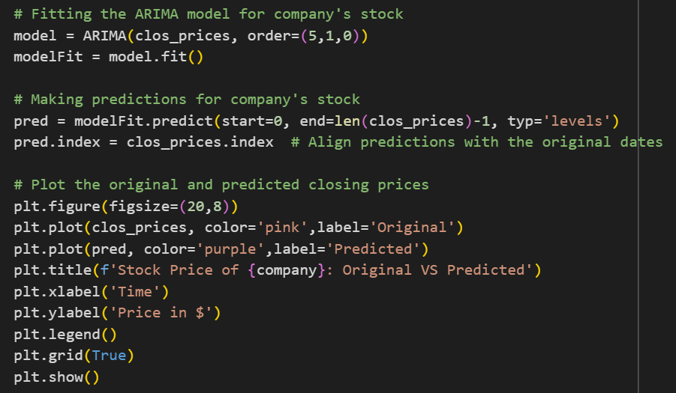
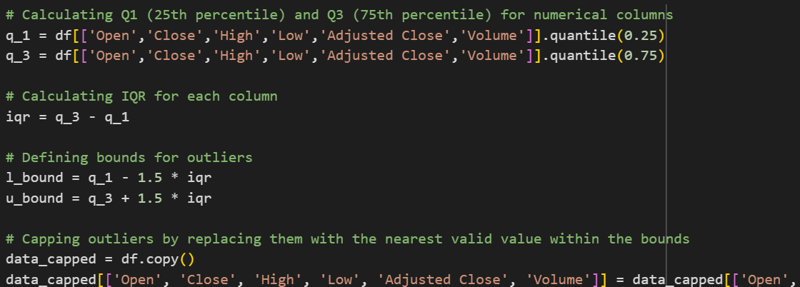
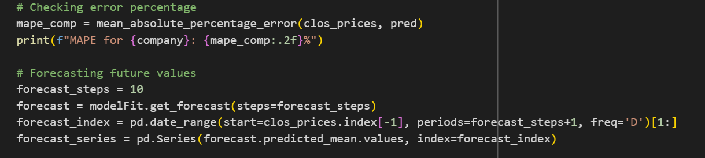
algorithmS
The IQR is calculated to find outliers in the features. We then cap the outliers because we replace them with the nearest possible value in the bounds.
This fits in an ARIMA model to the closing stock prices. The model predicts values over the time range given. It shows us the actual vs predicted values for visualisation.
This finds the MAPE to evaluate accuracy of the model. We then forecast the prices for the next 10 days using ARIMA model and make a forecast_series which is plotted.

Slide 11

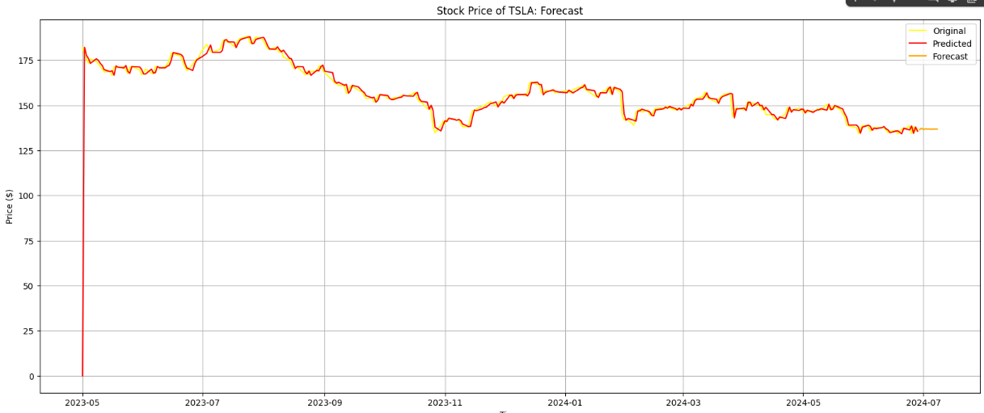
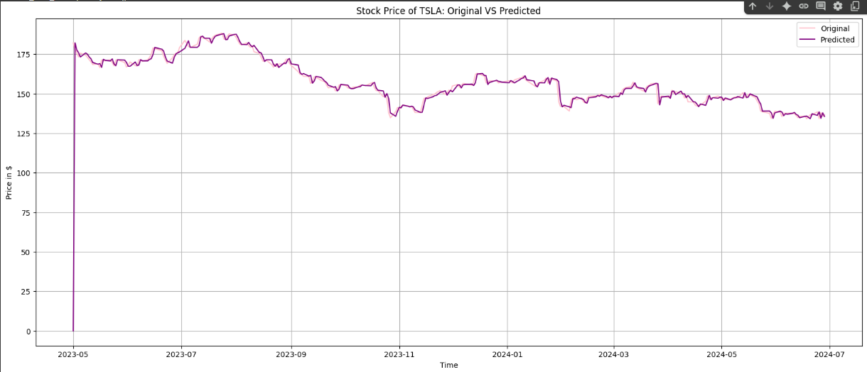
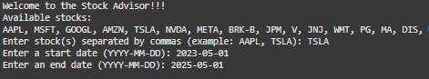
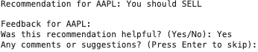
User FEEDBACK And Interaction
Users were able to enter stock ticker(s) and received individual recommendations of whether to buy/sell/hold the stock based on the forecast. We also graphed each of the stocks for the user to visualize.
We then prompted the user to give feedback by doing the following:
Adding interactive feedback prompts after each stock recommendation to gather user impressions
Asking whether the recommendation was helpful
Providing an optional field for suggestions or comments to help us improve

Slide 12
Future Enhancements
Now, what future enhancements could come about, per se? Our team is planning on implementing more models in order to forecast and predict a more accurate outcome. However, let it be known that, although the model is based on financial data and past instances, it should not be taken as financial advice.
In the future, we also aim to incorporate user feedback to refine our recommendations and adapt the system over time. Ultimately, we would like to make this a more interactive, transparent and informative experience for the user.

Slide 13
Final takeaways​
Finally, the impact that could come from this model is more accurate and less risky forecasting. Additionally, with the enhancement of this model, it will allow more people to easily access the world of stocks.

Slide 14
THANK YOU, stock advisors, our future
Anusha Desai
Kritik Jain
Neel Parimi
Vihaan Byahatti
Roman Sherman

